Slide 1
Premium Saver
Claims 101

Slide 2
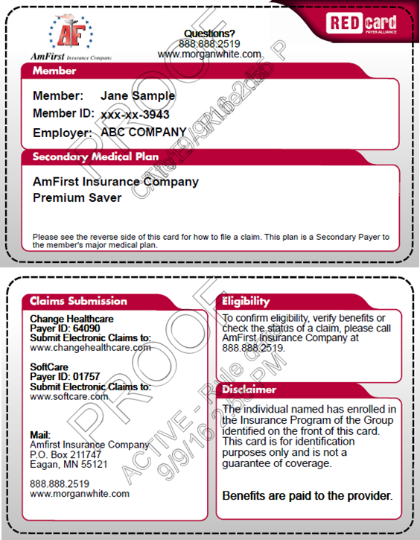
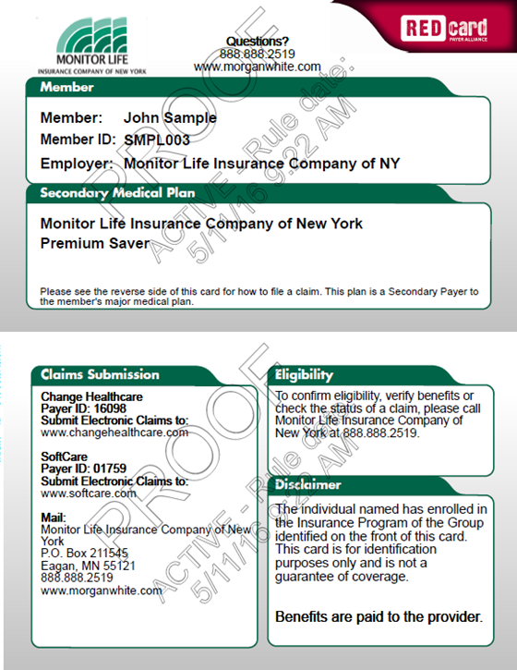
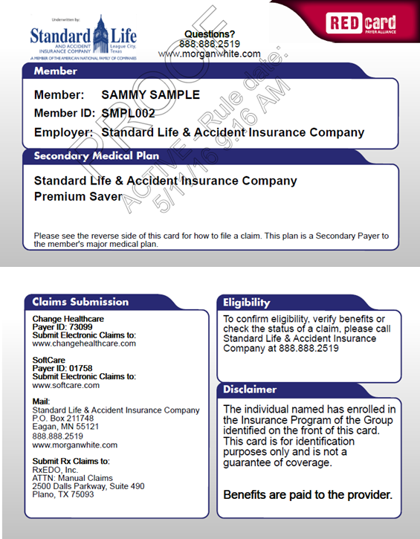
Premium Saver ID Card
Two Card System
The members should provide both primary and secondary ID cards to every provider.

Slide 3
How does the Premium Saver pay claims?

Slide 4
Provider Filing
Preferred Method
Quickest and Most Efficient way to file claims
The Premium Saver pays benefits to the providers based on the amounts applied towards the primary carrier deductible, coinsurance and/or copay.
Provider options for filing the Premium Saver
  Electronic Clearinghouse - Softcare or ChangeHealthcare
  Direct file feed from the primary carrier
  Paper claim received from mail - convert to electronic claim via OCR system

Slide 5
Member Filing
Required information for processing:
  Major Medical Explanation of Benefits
  Provider Walkout Statement or Billing Statement
  Proof of payment to provider - (If member has paid in full and seeks reimbursement)
This information can be submitted to our Claims Customer Service email Claims@Morganwhite.com.
Claims Customer Service – 1-888-888-2519

Slide 6


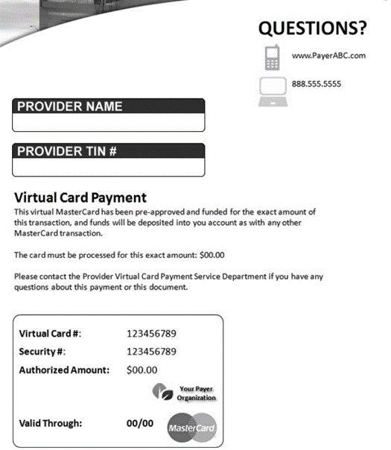


Slide 7
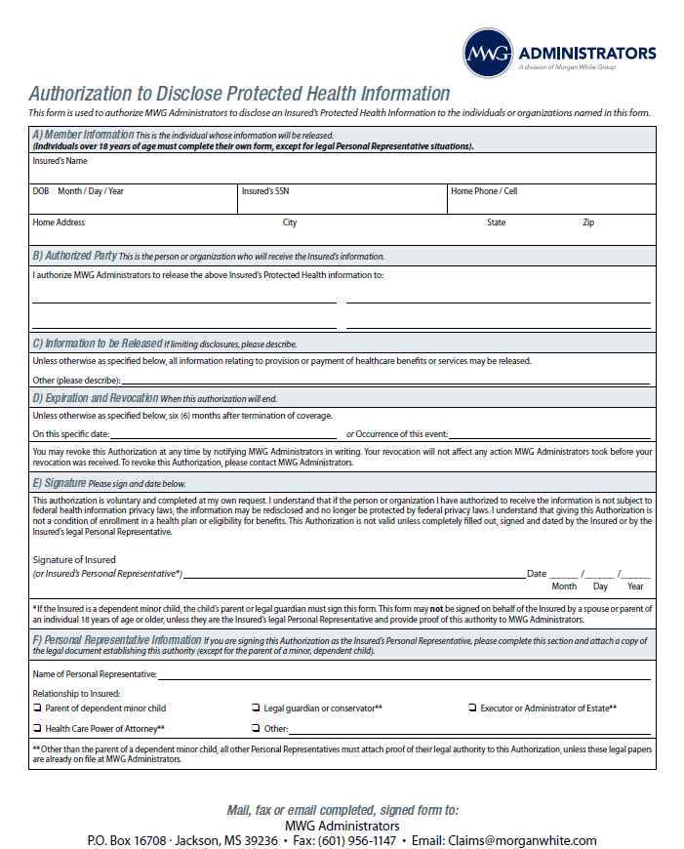
Agent Resource
If the agent or someone from the agent’s office needs to help a member understand or resolve a claims issue, we will need an MWG Administrators authorization form completed before we can assist in the issue.
Complete the form and send to
claims@morganwhite.com

